Slide 1
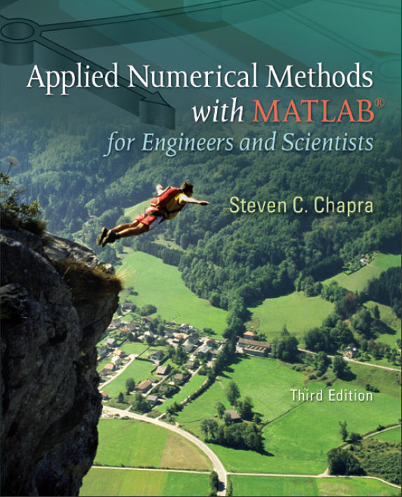
Part 4
Chapter 14
Linear Regression
PowerPoints organized by Dr. Michael R. Gustafson II, Duke University
All images copyright © The McGraw-Hill Companies, Inc. Permission required for reproduction or display.

Slide 2
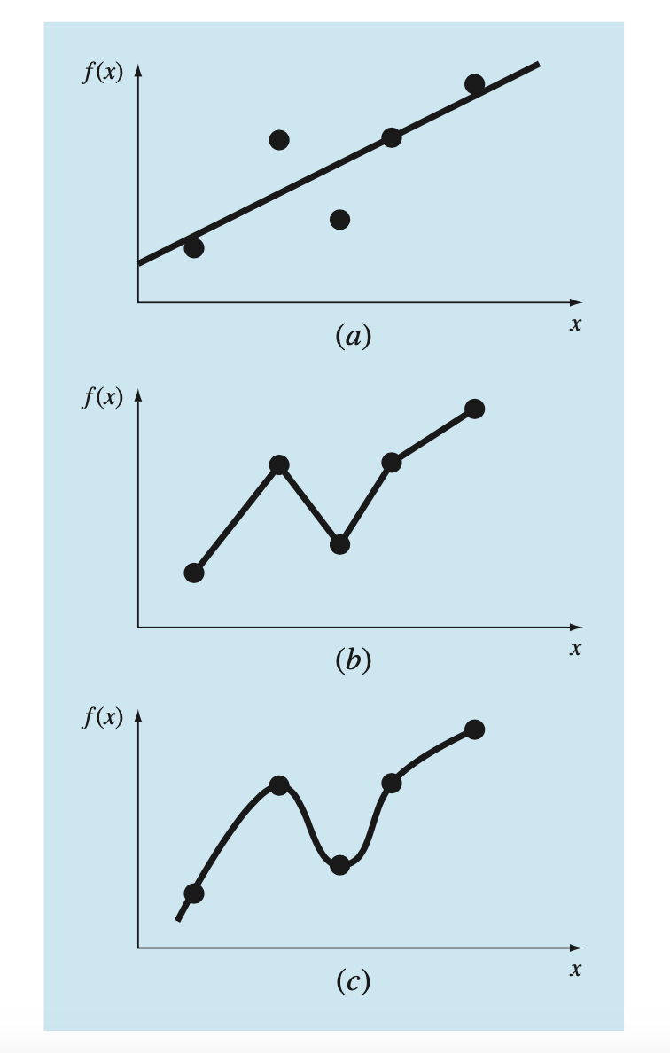

Slide 3
Chapter Objectives
Familiarizing yourself with some basic descriptive statistics and the normal distribution.
Knowing how to compute the slope and intercept of a best fit straight line with linear regression.
Knowing how to compute and understand the meaning of the coefficient of determination and the standard error of the estimate.
Understanding how to use transformations to linearize nonlinear equations so that they can be fit with linear regression.
Knowing how to implement linear regression with MATLAB.

Slide 4
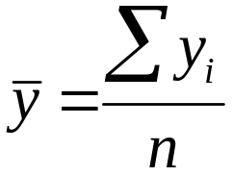
Statistics Review
Measure of Location
Arithmetic mean: the sum of the individual data points (y_{i}) divided by the number of points n:
Median: the midpoint of a group of data.
Mode: the value that occurs most frequently in a group of data.

Slide 5
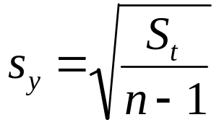
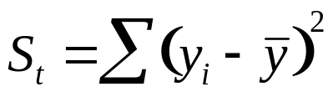
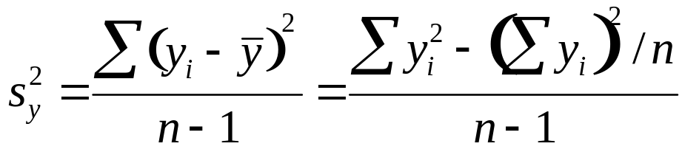
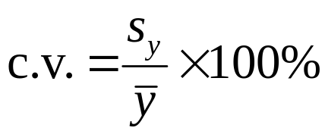
Statistics Review
Measures of Spread
Standard deviation:
where S_{t} is the sum of the squares of the data residuals:
and n-1 is referred to as the degrees of freedom.
Variance:
Coefficient of variation:

Slide 6
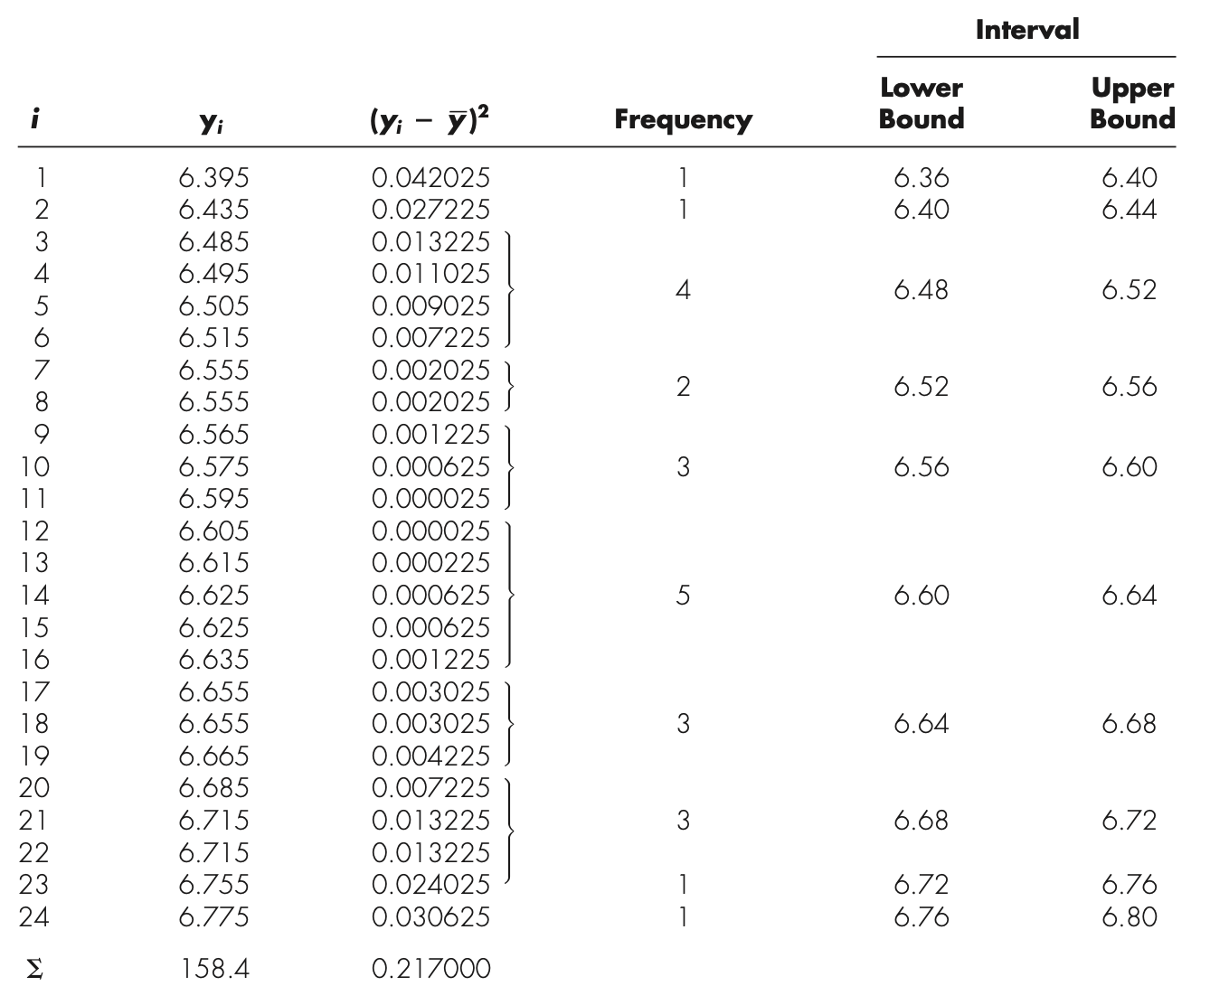

Slide 7
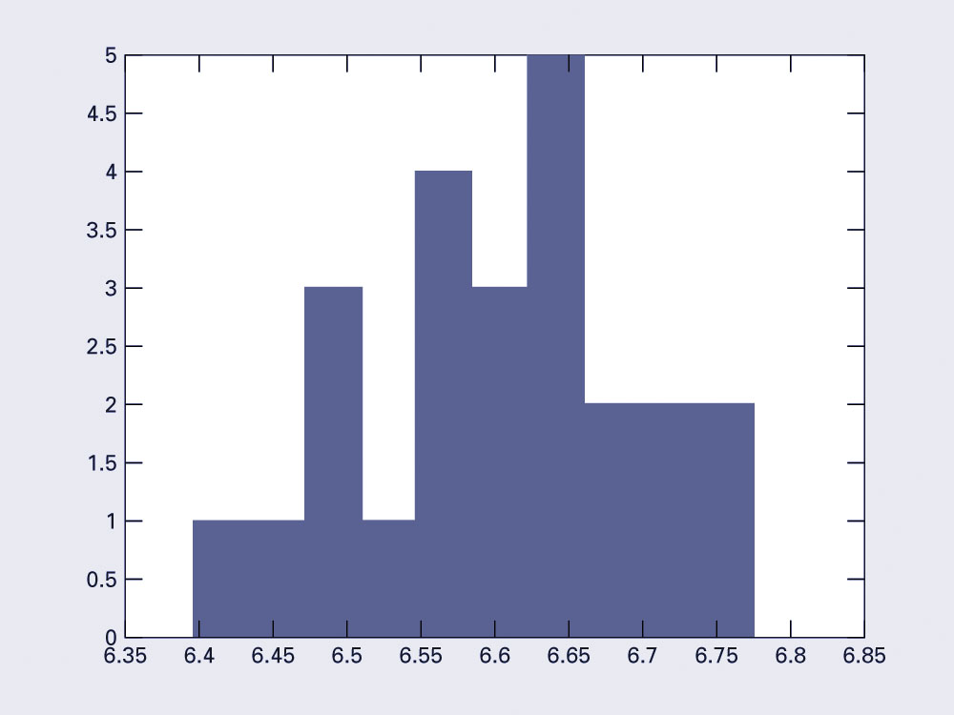
Histogram Example

Slide 8
Histograms in MATLAB
[n, x] = hist(s, x)
  Determine the number of elements in each bin of data in s. x is a vector containing the center values of the bins.
[n, x] = hist(s, m)
  Determine the number of elements in each bin of data in s using m bins. x will contain the centers of the bins. The default case is m=10
hist(s, x) or hist(s, m) or hist(s)
  With no output arguments, hist will actually produce a histogram.

Slide 9
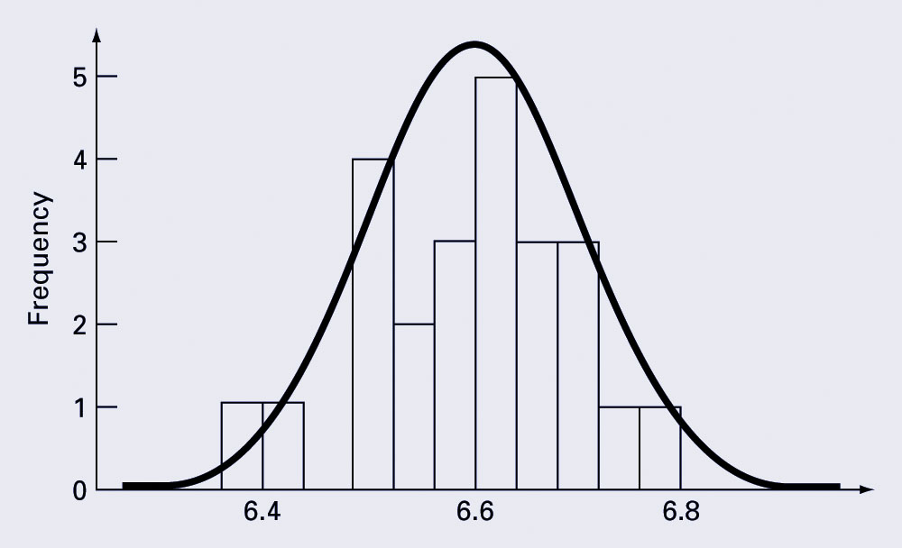
Normal Distribution

Slide 10
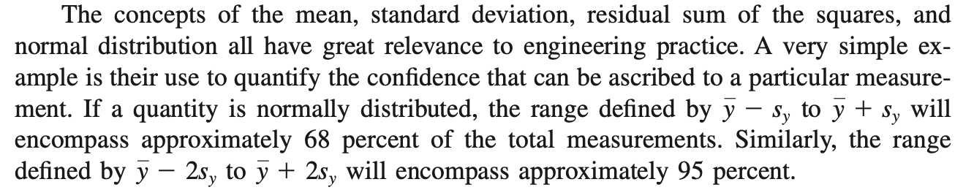

Slide 11
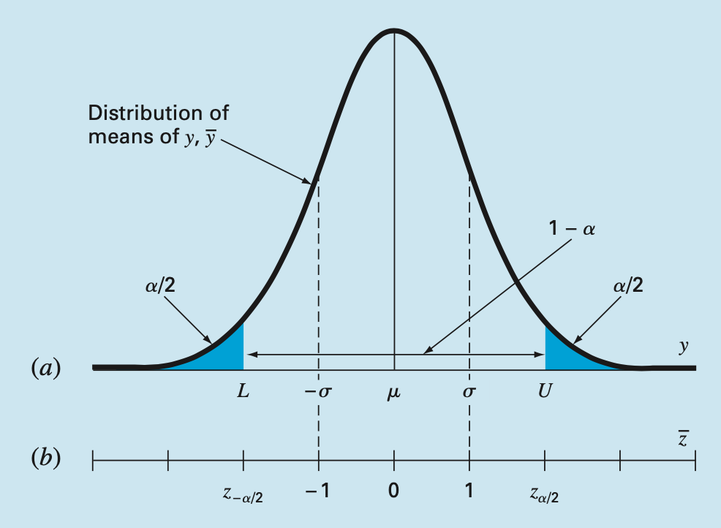

Slide 12
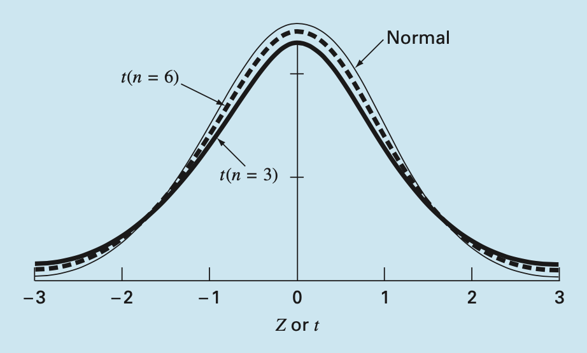

Slide 13
Descriptive Statistics in MATLAB
MATLAB has several built-in commands to compute and display descriptive statistics. Assuming some column vector s:
  mean(s), median(s), mode(s)
    Calculate the mean, median, and mode of s. mode is a part of the statistics toolbox.
  min(s), max(s)
    Calculate the minimum and maximum value in s.
  var(s), std(s)
    Calculate the variance and standard deviation of s
Note - if a matrix is given, the statistics will be returned for each column.

Slide 14
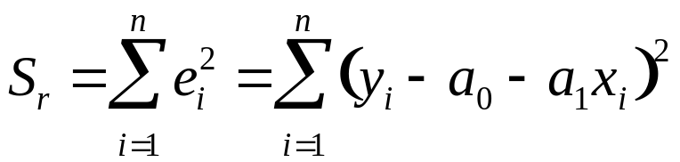
Linear Least-Squares Regression
Linear least-squares regression is a method to determine the “best” coefficients in a linear model for given data set.
“Best” for least-squares regression means minimizing the sum of the squares of the estimate residuals. For a straight line model, this gives:
This method will yield a unique line for a given set of data.

Slide 15

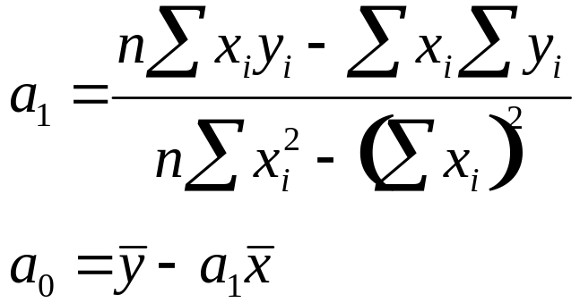
Least-Squares Fit of a Straight Line
Using the model:
the slope and intercept producing the best fit can be found using:

Slide 16
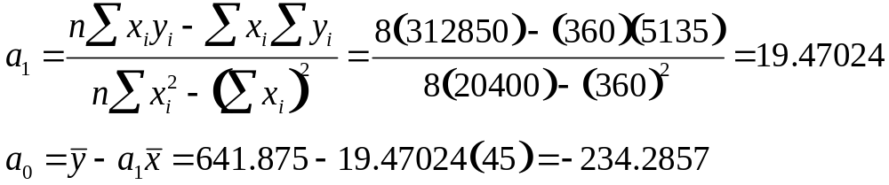
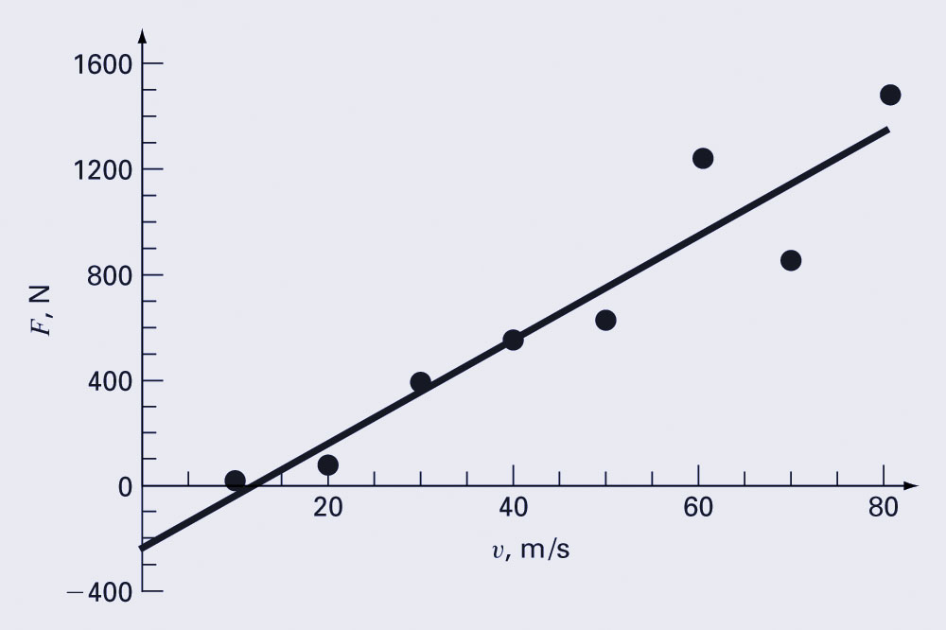
Example
 | V (m/s) | F (N)
i | x_{i} | y_{i} | (x_{i})² | x_{i}y_{i}
1 | 10 | 25 | 100 | 250
2 | 20 | 70 | 400 | 1400
3 | 30 | 380 | 900 | 11400
4 | 40 | 550 | 1600 | 22000
5 | 50 | 610 | 2500 | 30500
6 | 60 | 1220 | 3600 | 73200
7 | 70 | 830 | 4900 | 58100
8 | 80 | 1450 | 6400 | 116000
Σ | 360 | 5135 | 20400 | 312850

Slide 17
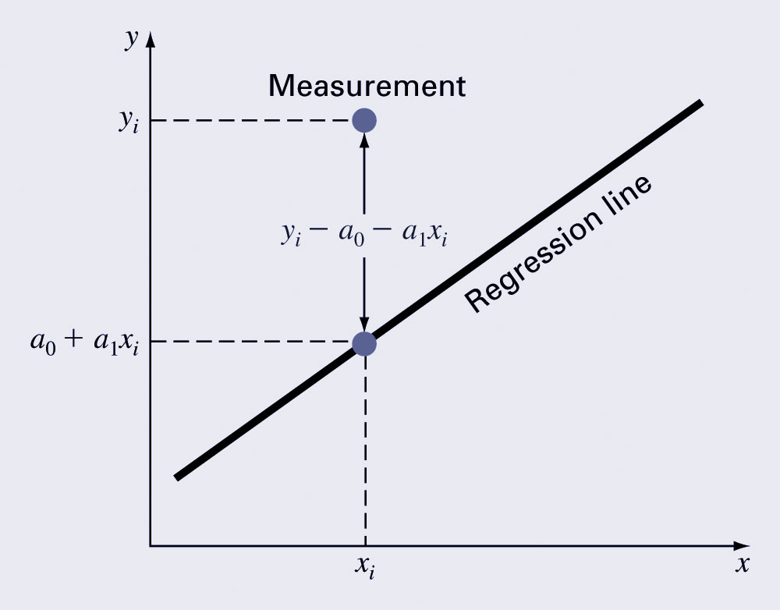
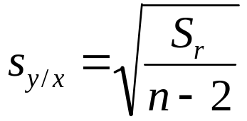
Quantification of Error
Recall for a straight line, the sum of the squares of the estimate residuals:
Standard error of the estimate:

Slide 18
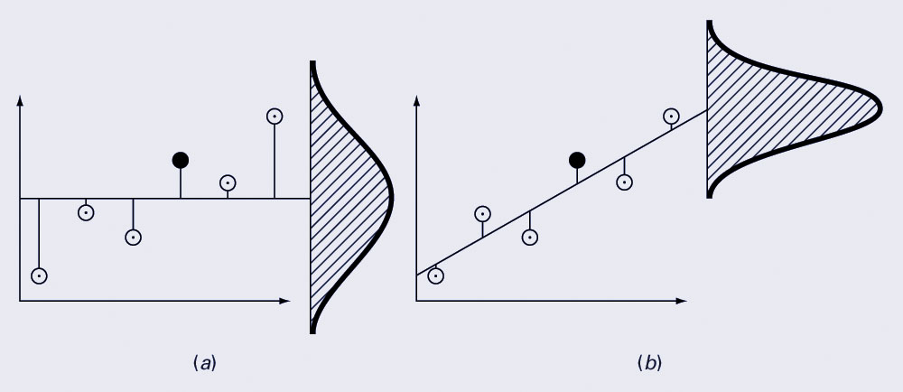
Standard Error of the Estimate
Regression data showing (a) the spread of data around the mean of the dependent data and (b) the spread of the data around the best fit line:
The reduction in spread represents the improvement due to linear regression.

Slide 19
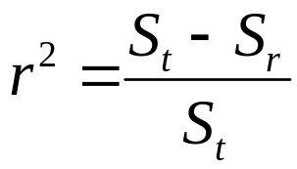
Coefficient of Determination
The coefficient of determination r² is the difference between the sum of the squares of the data residuals and the sum of the squares of the estimate residuals, normalized by the sum of the squares of the data residuals:
r² represents the percentage of the original uncertainty explained by the model.
For a perfect fit, S_{r}=0 and r²=1.
If r²=0, there is no improvement over simply picking the mean.
If r²<0, the model is worse than simply picking the mean!

Slide 20
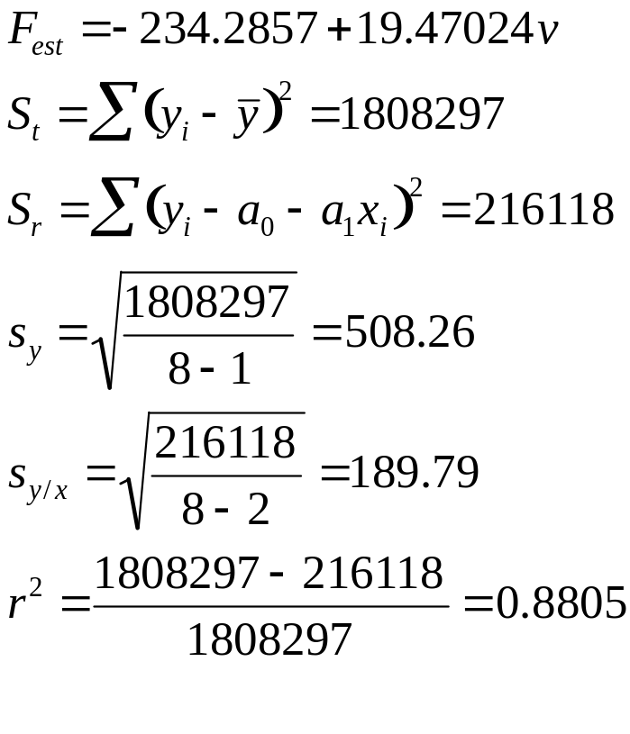
Example
 | V (m/s) | F (N)
i | x_{i} | y_{i} | a₀+a₁x_{i} | (y_{i}- ȳ)² | (y_{i}-a₀-a₁x_{i})²
1 | 10 | 25 | -39.58 | 380535 | 4171
2 | 20 | 70 | 155.12 | 327041 | 7245
3 | 30 | 380 | 349.82 | 68579 | 911
4 | 40 | 550 | 544.52 | 8441 | 30
5 | 50 | 610 | 739.23 | 1016 | 16699
6 | 60 | 1220 | 933.93 | 334229 | 81837
7 | 70 | 830 | 1128.63 | 35391 | 89180
8 | 80 | 1450 | 1323.33 | 653066 | 16044
Σ | 360 | 5135 |  | 1808297 | 216118
88.05% of the original uncertainty
has been explained by the
linear model

Slide 21
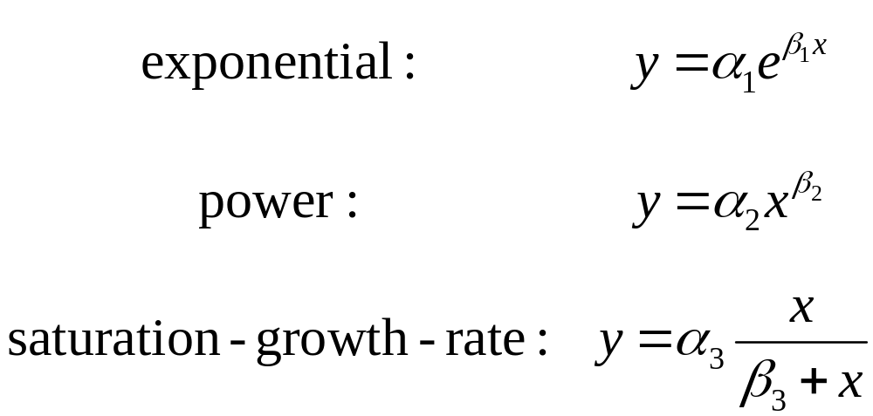
Nonlinear Relationships
Linear regression is predicated on the fact that the relationship between the dependent and independent variables is linear - this is not always the case.
Three common examples are:

Slide 22
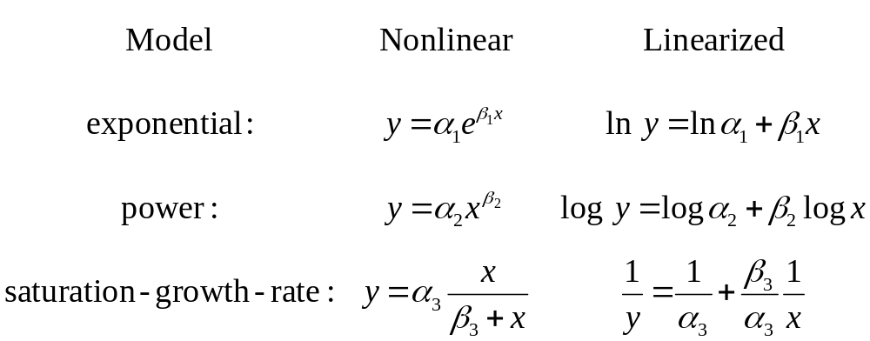
Linearization of Nonlinear Relationships
One option for finding the coefficients for a nonlinear fit is to linearize it. For the three common models, this may involve taking logarithms or inversion:

Slide 23
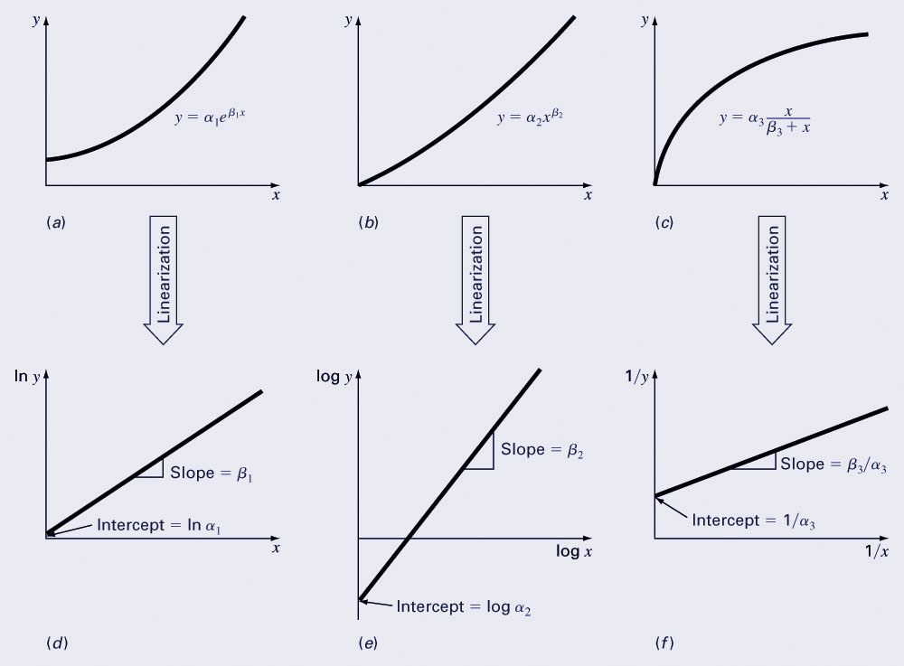
Transformation Examples

Slide 24
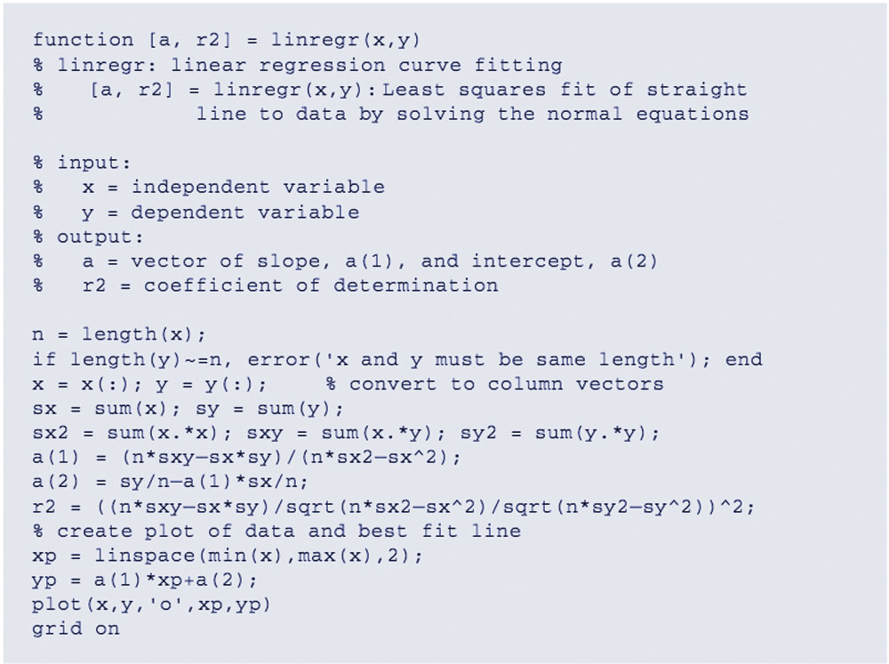
Linear Regression Program

Slide 25
MATLAB Functions
MATLAB has a built-in function polyfit that fits a least-squares nth order polynomial to data:
  p = polyfit(x, y, n)
    x: independent data
    y: dependent data
    n: order of polynomial to fit
    p: coefficients of polynomial
    f(x)=p₁x^{n}+p₂x^{n-1}+…+p_{n}x+p_{n+1}
MATLAB’s polyval command can be used to compute a value using the coefficients.
  y = polyval(p, x)

